Slide 1
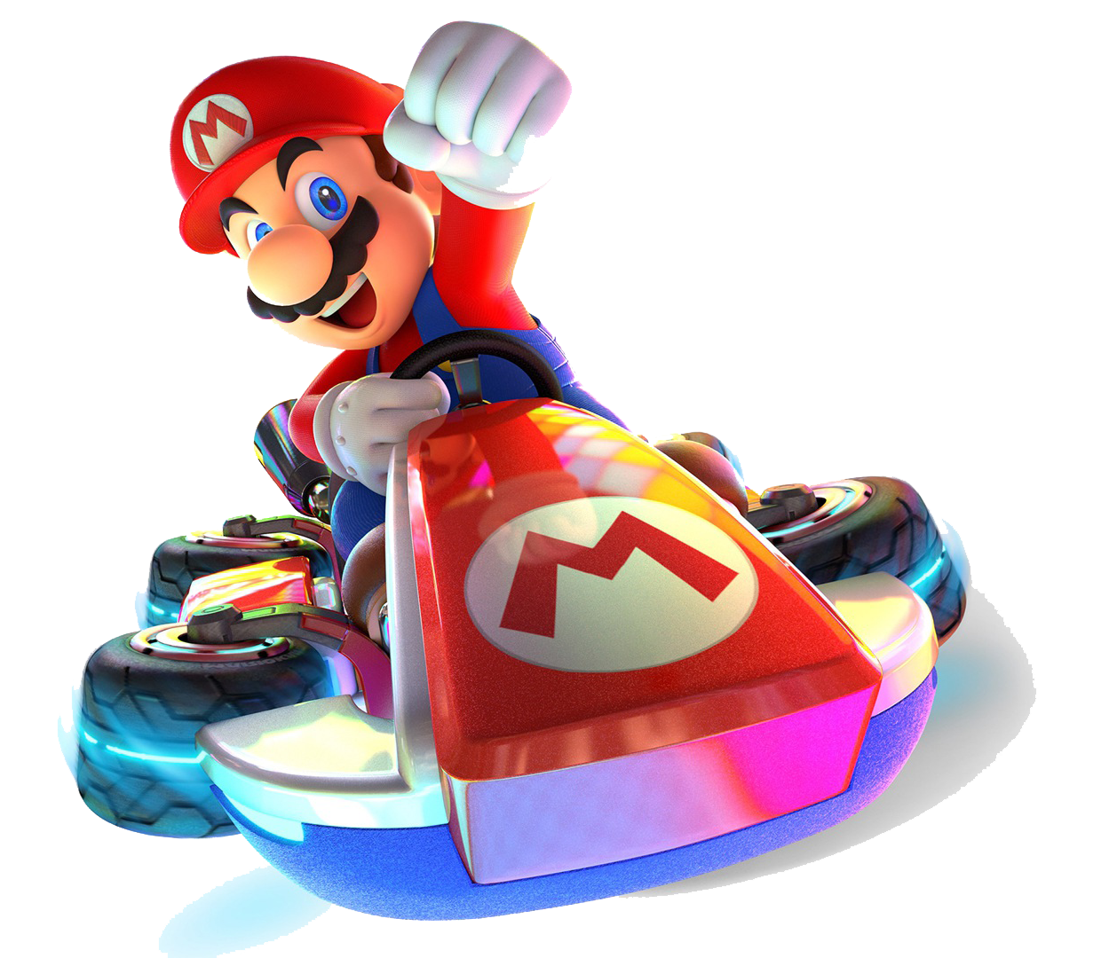
Reinforcement Learning for Autonomous Systems
Presented by Kristy Sakano | November 18th, 2024
Notes:
Keep it fun & engaging, and at the end, we’re going to try to train our own RL agent in Google Colabs.

Slide 2
Qualifying Autonomous Systems: Learning from Mario Kart for Robust Safety
Presented by Kristy Sakano | November ?, 2024 | Project in collaboration with Joe Mockler and Dr. Mumu Xu (advisor)

Slide 3
What is Artificial Intelligence?
Artificial Intelligence
Supervised Learning
Unsupervised Learning
Reinforcement Learning
👩🏻‍🏫
🔍
🎮
Reinforcement Learning
Reinforcement Learning Overview
X Lab Research into RL Applications
Aerospace Engineering Applications
Notes:
As you may have heard over the past few days, Artificial Intelligence is a big umbrella under which many different subfields and subareas of research exist. It’s generally recognized that the big three subareas within artificial intelligence are the following: supervised learning, unsupervised learning, and reinforcement learning.
Can anyone give me a 1-2 sentence explanation of what these are?
Excellent, that’s right on target. Here are my quick explanations, along with why I selected these particular emojis to represent each of the subareas.
First up, we have supervised learning represented by the teacher emoji. This kind of learning deals with labeled data sets, like the MNIST dataset that has a bunch of pictures of numbers, along with human-transcribed labels for each of them. We can create algorithms that will use portions of the dataset to learn on, and then evaluate its accuracy with the unused portion.
We also have unsupervised learning represented by the magnifying glass emoji. This learning pertains to datasets that do not have labels, so the AI has to explore and find patterns in the data without knowing what is correct or not.
Lastly, we have reinforcement learning, the focus of today’s topic – this type of AI pertains to learning through interaction and feedback with its environment. Reinforcement Learning is one of the most popular types of AI learning and is most famously used in different video game contexts.

Slide 4

🎮
Reinforcement Learning
🎮
Imagine yourself as a baby…
Reinforcement Learning Overview
X Lab Research into RL Applications
Aerospace Engineering Applications
Notes:
Let’s start by talking about the foundations of reinforcement learning. As one of the most intuitive subareas of Machine Learning, I’ll start with a quick analogy.
Imagine yourself as a baby. You’re just learning how the world works, and you haven’t quite figured out which actions lead to good outcomes and which actions lead to bad outcomes. You learn best by exploring your environment and seeing what the consequences are. Let’s start in the kitchen.

Slide 5


🎮
Reinforcement Learning
🎮
You crawled over to the fridge & found chocolate pudding. This is a high reward!
You like chocolate pudding, so you decide to check the fridge every day. This is exploitation.
Reinforcement Learning Overview
X Lab Research into RL Applications
Aerospace Engineering Applications
Notes:
As a baby, you crawl over to the fridge and open it up to see a huge bowl of chocolate pudding, your favorite snack. This is a high reward because you love chocolate pudding!
(1) In the future, you might be inclined to walk towards the fridge in case it’s holding more chocolate pudding. If you choose to do so, you’re performing a strategy called exploitation.
But what happens if you want an even better reward than chocolate pudding?

Slide 6


🎮
Reinforcement Learning
🎮
You crawled over to the stove & burned your hand. This is a penalty!
You decided to do something new, instead of following the original plan. This is exploration.
Reinforcement Learning Overview
X Lab Research into RL Applications
Aerospace Engineering Applications
Notes:
One day, you decided to try something a little different. Maybe you’re hoping that moving in a different direction will give you an even better reward, like pistachio ice cream. You decide to crawl over to the stove, but instead of finding delicious desserts inside, you burn your hand. This is a penalty, or a negative reward.
(2) Even though your new strategy didn’t work out, you still tried something new. This is called exploration.

Slide 7
🎮
Reinforcement Learning
🎮
State (S): The agent’s current state, including its position, health status, location, etc.
Action (A): The set of all possible moves the agent can take from the current state.
Transition (T): How the agent moves from one state to another state.
Reward (R): The feedback you get from the environment after taking an action.
Reinforcement Learning Overview
X Lab Research into RL Applications
Aerospace Engineering Applications
Notes:
We’re now ready to explain the traditional reinforcement learning model called SATR. No, it doesn’t reference half-goat half-men creatures, but it’s instead an acronym for State, Action, Transition, and Reward.
The state of an agent refers to the current situation or snapshot of the agent & the environment it is in. This information can include the agent’s position, health statue, location, or anything else pertinent or relevant.
The action set of an agent refers to a set of all possible moves an agent can take from its current state. In the context of the baby, we can crawl to the fridge, stove, or another location within the house, but until we learn how to climb stairs, we can’t go upstairs and that’s outside of our action set.
The T stands for transition function – this refers to the movement from the current state to the next state after an action is taken. Sometimes, it’s obvious that where you’re heading is where you’ll end up, but other times, you might try to walk towards the fridge but accidentally end up at the sink. In reinforcement learning, this is usually represented as some kind of probability distribution.
And lastly, the R stands for reward – this refers to the feedback you get from the environment after taking an action. It can either be a high reward, like chocolate pudding, an even higher reward, like pistachio ice cream, or it can be a penalty, like getting a burn on your hand.

Slide 8
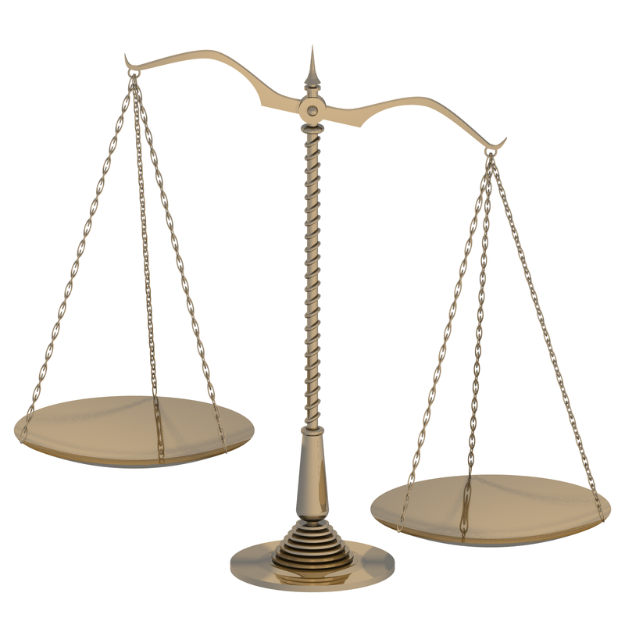
🎮
Reinforcement Learning
🎮
State (S): The agent’s current state, including its position, health status, location, etc.
Action (A): The set of all possible moves the agent can take from the current state.
Transition (T): How the agent moves from one state to another state.
Reward (R): The feedback you get from the environment after taking an action.
Exploit – chocolate pudding is good, no need to find something new!
Explore more – maybe you will find pistachio ice cream!
Exploration: Trying new actions which have unknown outcomes.
Exploitation: Choosing the best option based on current knowledge.
Reinforcement Learning Overview
X Lab Research into RL Applications
Aerospace Engineering Applications
Notes:
We also touched briefly on the exploration-exploitation tradeoff. Here, we can either explore more and try new actions which have unknown outcomes in the hopes of finding an outcome with an even greater reward.
The flip is to exploit our current best option and be satisfied with the reward we are currently receiving.
This is expressed as a ratio in the RL algorithm and can change over time. For example, we may prioritize exploring the environment early on, but then prefer exploiting our best option once we’ve explored the environment quite a bit.

Slide 9




What are rewards?
Reinforcement Learning Overview
X Lab Research into RL Applications
Aerospace Engineering Applications
Notes:
Let’s talk more about rewards. This is something hardcoded into your environment, and we’ll demonstrate this concept in this 3x3 grid world.
Say you’re Princess Peach and your goal is to navigate to the top left corner on this grid world. You can collect tiny coins along your way, increasing your score. Once you get to the goal square, you get a big bonus of 10 coins. But if you happen to walk onto the square that has the Goomba or the Piranha plant, your score drops by 1 point. The game ends when you reach the goal location.

Slide 10
Attempt 1
Current Score: 0
Reinforcement Learning Overview
X Lab Research into RL Applications
Aerospace Engineering Applications
Notes:
Let’s start. Princess Peach doesn’t know what the outcomes will be for any of her actions, even though it’s obvious to us. She doesn’t have any previous knowledge to exploit, so we start with exploration. Peach decides to move up one square…. And nothing happens. Her reward is nothing, so she tries again.

Slide 11
Attempt 1
Current Score: 0
Current Score: -1
Reinforcement Learning Overview
X Lab Research into RL Applications
Aerospace Engineering Applications
Notes:
This time, she moves up again, and uh oh! She landed on the Piranha plant. Her score drops by one point.

Slide 12
Attempt 1
Current Score: -1
Reinforcement Learning Overview
X Lab Research into RL Applications
Aerospace Engineering Applications
Notes:
Peach realizes this is a bad idea so she moves back down again. Again, she doesn’t receive a reward on this square and her current score is still at negative one.

Slide 13
Attempt 1
Current Score: -1
Current Score: -1 + 1 + 10 = 10
Reinforcement Learning Overview
X Lab Research into RL Applications
Aerospace Engineering Applications
Notes:
Peach then moves left twice, and eventually decides to move up once. On her way to the goal, she gathers one mini coin worth 1 point, and the goal is worth 10 coins, so Peach’s overall score is 10 coins.

Slide 14
Attempt 2
Attempt 1 Score: 10
Current Score: 1
Attempt 1 Score: 10
Current Score: 0
Reinforcement Learning Overview
X Lab Research into RL Applications
Aerospace Engineering Applications
Notes:
Let’s try again – we’re now on our second attempt and the environment has reset. Peach learned that going up twice leads to a penalty, so she decides to try something else by going left this time.

Slide 15
Attempt 2
Attempt 1 Score: 10
Current Score: 1
Attempt 1 Score: 10
Current Score: 1
Attempt 1 Score: 10
Current Score: 0
Reinforcement Learning Overview
X Lab Research into RL Applications
Aerospace Engineering Applications
Notes:
Neat! Moving to the left gained Peach one coin. Peach then decides to randomly move up this time.

Slide 16
Attempt 2
Attempt 1 Score: 10
Current Score: 12
Attempt 1 Score: 10
Current Score: 0
Reinforcement Learning Overview
X Lab Research into RL Applications
Aerospace Engineering Applications
Notes:
No new coins, but no penalty this time either. Peach remembers that she’s been in this spot before, and that by moving left and up, she is able to gain more coins. Peach decides to exploit her previous knowledge and executes that strategy.

Slide 17
Attempt 2
Attempt 1 Score: 10
Current Score: 12 [new high score!]
Reinforcement Learning Overview
X Lab Research into RL Applications
Aerospace Engineering Applications
Notes:
Earning her a total of 12 coins. Let’s pause here.
In this second attempt, Peach used both exploit and explore strategies. Instead of heading north initially (and eventually running into the Pirhana plant), Peach decided to randomly head left. She then headed north randomly, found herself at a previous position, and exploited previous strategy to get herself to the goal.
We can stop training her. We’ve found a satisfactory strategy that avoids the hazards in the scenario, and gains us plenty of intermediary coins on our way to the goal. But what if Peach wanted to try again?

Slide 18
When should we stop training?
Reinforcement Learning Overview
X Lab Research into RL Applications
Aerospace Engineering Applications
Notes:
We could alternatively keep training, and this may lead to a better payout, like the route in green that resulted in a score of 13. Or, we may accidentally take another detour through a hazard like the Goomba, and end up with a payout of 10.
Another question we ask ourselves as RL designers is… when is it appropriate to stop training? We could’ve stopped after the second attempt since we improved on the previous score in attempt 1. But if we kept going, we could’ve gotten even higher rewards, like this green route.

Slide 19
Safety in Reinforcement Learning
Adaptive Flight Control
Autonomous Navigation
Obstacle Avoidance
Fault Detection & Mitigation
Verification & Validation (V&V)
Certification of Autonomous Systems
Reinforcement Learning Overview
X Lab Research into RL Applications
Aerospace Engineering Applications
Notes:
Now that we’ve covered the basics of how reinforcement learning (RL) is trained, let’s pivot to discuss what our lab is working on. To motivate this, we’ll discuss applications of reinforcement learning in aerospace engineering that prioritize safety.
First up is adaptive flight control systems, which are controllers that adjust to real-time conditions. By adapting on the fly, these systems can enhance both the stability & performance of aircraft. They can also optimize for fuel-efficiency while respecting safety constraints, like ensuring that the aircraft only undertake maneuvers that are feasible given its remaining fuel.
Secondly is autonomous navigation and obstacle avoidance, which relies on safety-prioritized planning. Here, autonomous agents can be programmed to avoid dangerous or restricted areas, and add safety buffers to obstacles or other aircraft, reducing collision risk and improving asset safety.
Next up is real-time fault detection and mitigation. By employing RL to monitor the health of critical systems, we ca reduce the need for immediate human intervention in situations like engine failure or control malfunctions.
Verification and Validation is the rigorous process of testing and analyzing a system to ensure it performs as intended and meets the specific needs of its operational environment. In the case of RL, V&V involves testing the learned behaviors to confirm they’re reliable, safe, and robust in diverse environments.
And finally, certifying autonomous systems in aerospace is essential to regulate their permissible user cases. Certification begins with formalizing models—mathematically defining the rules and expected behaviors of these systems. It then involves robust simulation, where we expose the system to a variety of scenarios to stress-test its responses. These steps aim to establish trust in autonomous systems, enabling their use in safety-critical aerospace applications.
Together, these areas showcase how RL can enhance safety in aerospace engineering, from adaptive control and autonomous navigation to rigorous testing and certification. Let’s take a closer look at the brown and yellow hexagons, Certification of Autonomous Systems and V&V.

Slide 20
What is currently being done in autonomous V&V?
Does it work?
No verification in the loop, no formal models of the autonomous systems, cannot specify acceptable risks
The Current Solution
Autonomous Systems are demoed in clearly defined scenarios, which do not capture environment complexity.
The Problem
Autonomous Systems need to be verified before they fly, but the environments are dynamic & complex
Reinforcement Learning Overview
X Lab Research into RL Applications
Aerospace Engineering Applications
Notes:
We’re teeing up to talking about my group’s research, but first let’s motivate what’s being done in autonomous verification and validation.
(1) What’s our problem? We have autonomous systems that need to be verified before they fly. However, the environments they’re operating in are dynamic and complex, so while an autonomous system can be checked in pristine, obstacle-free, perfect environment, they are not verified in dynamic nor complex environments.
(2) Current solutions to verifying autonomous systems is to demo them in clearly defined scenarios, often scenarios that lack unexpected behaviors or edge cases. This may mean simulation-based testing, or real life demonstrations out on the flight field.
(3) These testbeds often lack environment complexity and are only viable for a limited subset of valid scenarios. There is no quantification of risks when they do appear, and we cannot specify acceptable or unacceptable behavior in mathematical models of the system.

Slide 21
What is our project about? The Iterative Cycle 🔄
Construct Local Rules for Scenario
Simulate Scenario with RL
Collect Performance Data
Identify Edge Cases
Example: Construct rules that optimize for good behavior & avoid bad behavior.
Example: no driving over 60 mph! No bumping into obstacles or walls!
Example: Run many scenarios and collect vehicular performance data.
Example: Use Mario Kart to simulate our autonomous vehicle.
Reinforcement Learning Overview
X Lab Research into RL Applications
Aerospace Engineering Applications
Notes:
So let’s talk about our group’s research! The X lab has a variety of different focus areas, but we all center on control of dynamical systems.
(1) Our research project focuses on building and constructing specifications, or rules, for scenarios that we test autonomous systems in. We start by constructing a subset of local rules for our scenario. This could be rules like speed limits, such as no driving over 60 mph, or more specific behavior rules like avoiding obstacles and walls. We can get even more specific in our scenario, such as changing reaction times for different environmental conditions, like increasing our reaction time in adverse weather like rain.
(2) We then will simulate our scenario in an autonomous vehicle simulator. There are many different open-source simulators available, such as high-fidelity simulators like CARLA, but we chose Mario Kart for its ease of use & customizable environments.
(3) We will train a RL agent based on the rules set in the environment, and collect vehicular performance data in a variety of different environments, like vehicular pose, or how many times Mario went over the cliff.
(4) Lastly, we’ll identify any edge cases or bad behaviors. From these bad behaviors, we can construct rules that optimize for good behavior and avoid bad behavior.
For example, maybe our 60 mph speed limit works the majority of the time, unless we’re dealing with a track that has a lot of cliff-edge driving and steep curves. We might need to more strictly restrict the speed limit around curves to prevent our cars from spinning out of control and going over the cliff!

Slide 22

🍄🏎️ + 🦺 + 🎮 Mario Kart + Safety + Reinforcement Learning
Reinforcement Learning Overview
X Lab Research into RL Applications
Aerospace Engineering Applications
Notes:
So, what does this look like in practice?
Well, it’s not much. This is just a small snippet of us training the Mario Kart agent. You’ll observe that I set it up to train about 6 agents simultaneously to speed things up, and yet somehow, Mario has yet to figure out how to actually move the car forward.
Reinforcement Learning is a lot like that – in the beginning of our training phase, we’ll stumble a lot and make very little progress. But once Mario figures out how to move the car forward, maybe in hour two, training will really take off.
By the end of our training process, we should see Mario successfully moving around the track, following the local rules we specified for our scenario.

Slide 23
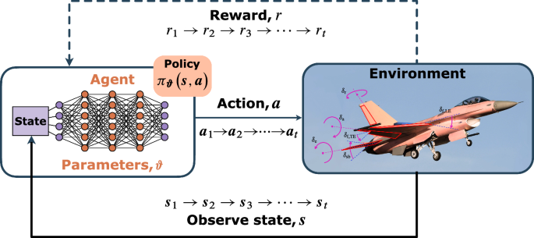
RL Applications in Aerospace Engineering ✈️
Maintenance Scheduling
Supply Chain Optimization
Energy Management for Electric or Hybrid-Electric Aircrafts
Reinforcement Learning Overview
X Lab Research into RL Applications
Aerospace Engineering Applications
Notes:
Outside of safety, there are dozens of reinforcement learning applications in aerospace engineering. I’ll highlight three today.
Consider maintenance scheduling – RL can assist in predicting and optimizing maintenance schedules for aircrafts by learning patterns to predict when systems are likely to fail, allowing for proactive maintenance.
Another area is in supply chain optimization – regarding logistics and inventory management within aerospace manufacturing, RL can ensure that parts and components are delivered on time and efficiently.
Lastly, another area that RL could be applied is in energy management for electric or hybrid-electric aircrafts. RL can optimize energy usage by determining when to use stored energy and when to recharge, just like Mario deciding when to accelerate and deaccelerate on the track.

Slide 24
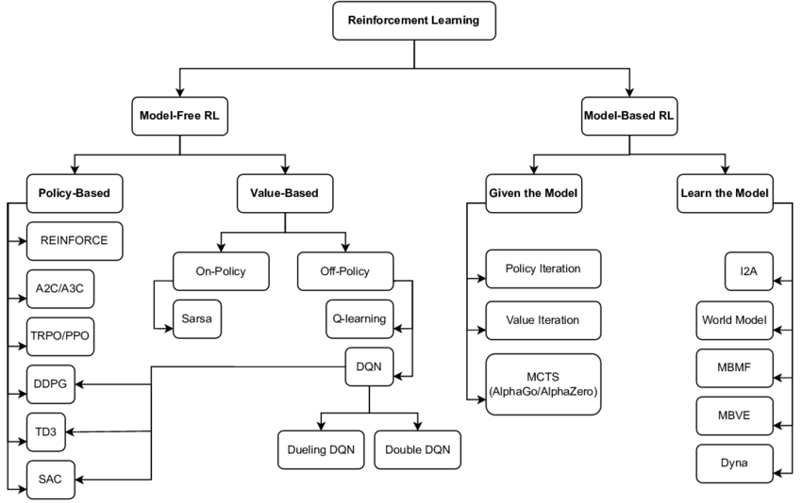
What are some subareas within RL?
Reinforcement Learning Overview
X Lab Research into RL Applications
Aerospace Engineering Applications
Notes:
Here’s a list of all the subareas within reinforcement learning. As you can see there are many different flavors of Reinforcement Learning, and the specific variety demonstrated in the homework is called Value Iteration. You can read more about it online, but the finer details aren’t too terribly important for finishing the homework.

Slide 25
Reward Shaping 101
Reinforcement Learning Overview
X Lab Research into RL Applications
Aerospace Engineering Applications
Notes:
Alright, let’s go back to this image of our Princess Peach environment. We previously established that the green path is the optimal path that maximizes our reward.
(1) But what happens when we move the coins over here?
(2) This would be our new optimal policy. Now, our best strategy is to go up, then left twice, and then up again. This avoids the hazards at the top of the map and maximizes the number of coins we can get.
The homework assignment deals with this topic – by moving the coins in the environment, we can alter the optimal policy for the agent. We’ll be doing this in Google Colab, and you’ll see the impact of changing the coin location on the preferred agent policy after training.

